Slide 1
E-DUCATION_PWD
EASY ACCESS ON QUALITY EDUCATION for PEOPLE WITH DISABILITIES

Slide 2
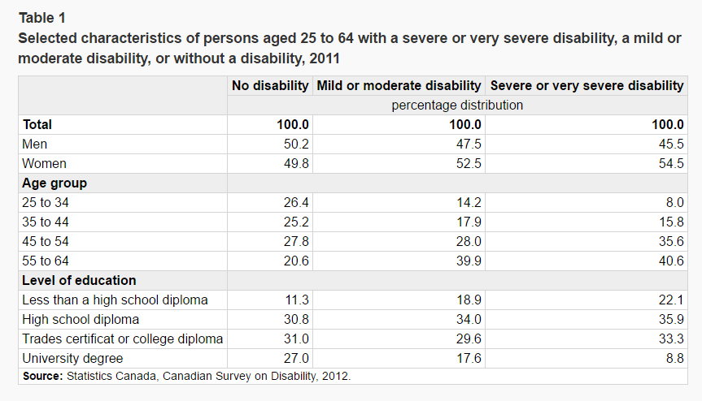
PROBLEM
People with disabilities are less-educated resulting to lower employment rates. On average, only 9% of PWD with severe disability and 17.6% with mild disability have university degrees compared to 27% to those without disability.

Slide 3

DIFFICULTIES OF PWD TO ACCESS QUALITY EDUCATION
Transport to/from school premises and high cost
Discrimination and harassment by non-disabled students
Insufficient funds from government for equipment and aids for PWD students
Source photo: http://thenetwork-co.org/

Slide 4

E-DUCATION_PWD
Online school for people with disabilities
Real-time classes delivered online thru video/audio conference
Accessible anywhere and students can interact with other students
Source photo: http://ichef.bbci.co.uk/

Slide 5

THE PROTOTYPE
Source photo: http://www.slideshare.net/

Slide 6

PWD will improve their lives significantly
Gaining high quality education without DIFFICULTIES with E-DUCATION_PWD will help them increase their chances to get employment.
Source Photo: http://www.witf.org/

Slide 7
SCHEDULE
Stages | Tasks | Days Required | Completion Date
1 | Planning and requirements gathering | 30 | January 09, 2017
2 | Defining the requirements | 15 | January 30, 2017
3 | Designing the project | 35 | March 09, 2017
4 | Developing the project | 100 | June 12, 2017
5 | Testing the project | 15 | June 30, 2017
6 | Deploying the project | 15 | July 10, 2017

Slide 8
BUDGET
Item | Description | Cost (CAD)
1 | Development cost (includes surveys, salaries for systems analysts, programmers and project lead) | 100,000.00
2 | Rental office cost (for 6 months) | 10,000.00
3 | Equipment cost (e.g. software tools, computers, i-cloud subscription) | 50,000.00
4 | Office supplies & utilities | 5,000.00
5 | 1-month maintenance and support after successful deployment | 5,000.00
 | Total | CAD 180,000.00

Slide 9

UNIQUE VALUE PROPOSITION
It help improves the lives of people with disabilities
Equal access to quality education
Provides comfortable learning environment
Source photo: http://orlandowheelchairtransportation.com/

Slide 10

PROFILE
Jesus Jr Ancheta
PROJECT MANAGER
Web developer for 5+ years
Cisco CCENT certified
Database management expert
Certified tutor level 1 by CRLA
5+ years Logistics experience
Certified Logistics Professional

Slide 11
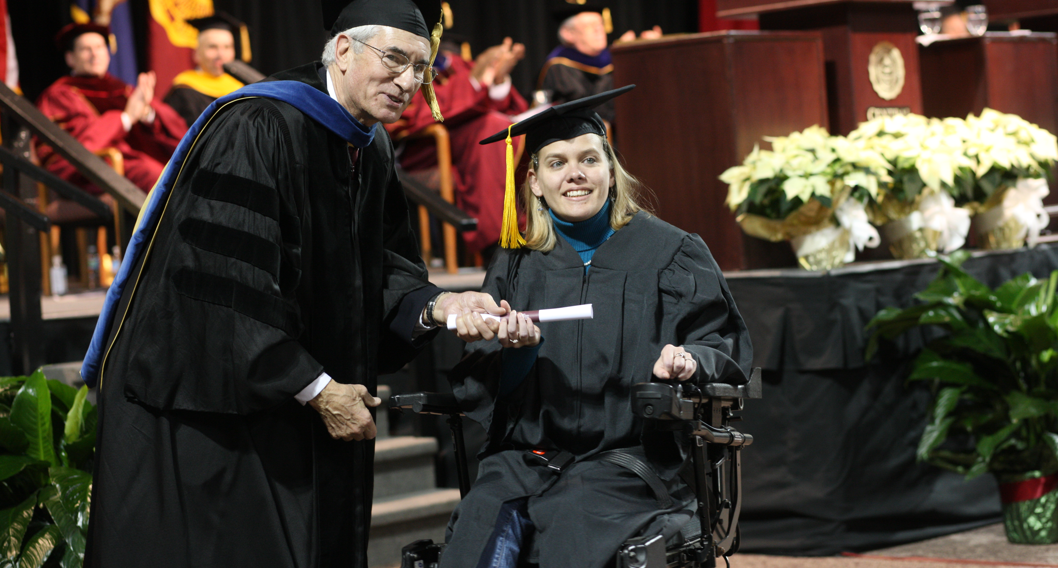
THANK YOU
Source photo: https://www.cmich.edu/

